Slide 1
Project on Gym Management System Prepared By:- Aayush Paudel
Subash Rijal
Sujan Sigdel
Sulav Lamsal

Slide 2
Gym Management System
Introduction : Our Gym Management Software is a comprehensive system for efficiently managing gym and health club memberships. It allows you to keep detailed records of members, their memberships, and facilitates seamless communication between staff and members. The software includes a booking system, point of sale functionality, and provides various reports for effective club management. With features like customer data entry, tracking membership fees and plans, and monitoring physical fitness, it ensures high-quality services to members. The system also manages information on machinery, coaches, and handles various gym services. The clear structure, aided by data flow diagrams, simplifies understanding and enhances the overall efficiency of gym operations.

Slide 3
Objectives of the Gym Management System
1) The main objective of the project is to develop software that facilitates the data storage , data maintenance and its retrieval for the gym in an igneous way .
2) To store the record of the customers , the staff that has the privileges to access , modify and delete any record and finally the service , gym provides to its customers .
3) Also , only the staff has the privilege to access any database and make the required changes , if necessary .
4) To develop easy to use software which handles the customer-staff relationship in a effective manner .
5) To develop a user friendly system that requires minimal user training . Most of features and function are similar to those on any windows platform .

Slide 4
DFD

Slide 5
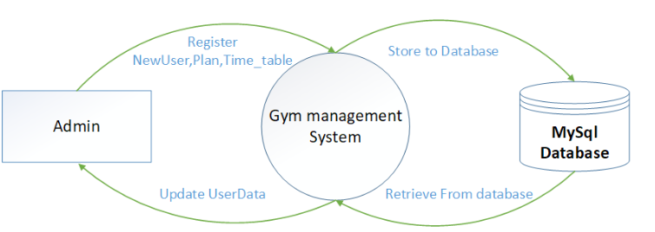
Context Level DFD

Slide 6
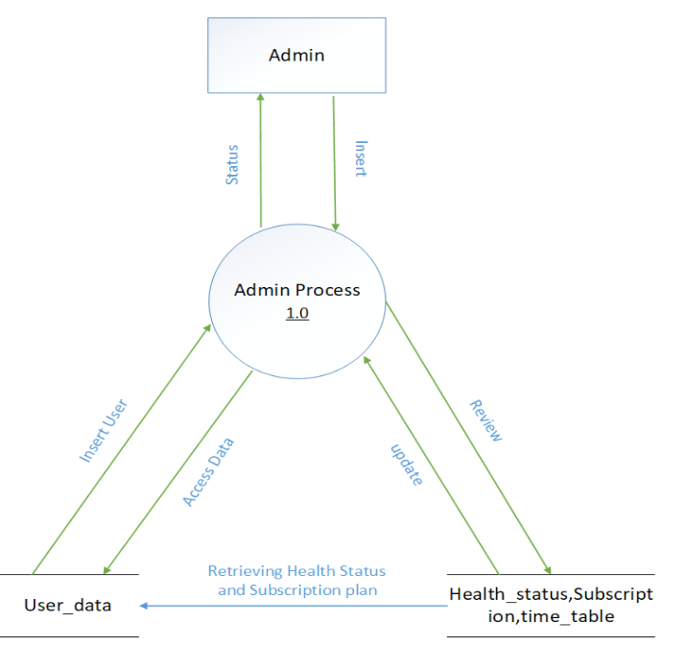
Level-1 DFD for Admin Process

Slide 7
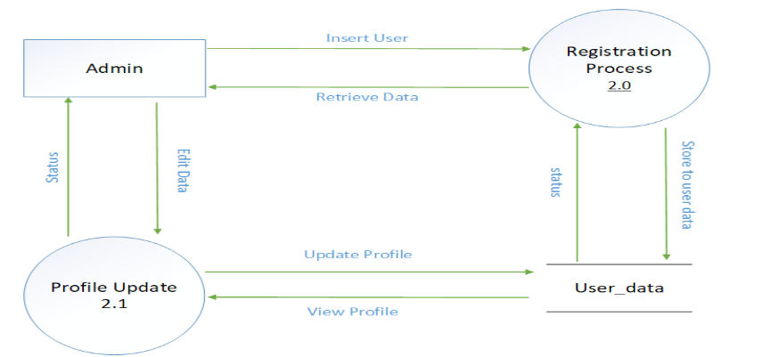
Level-1 DFD User Registration and Profile Update

Slide 8
ER-Diagram

Slide 9
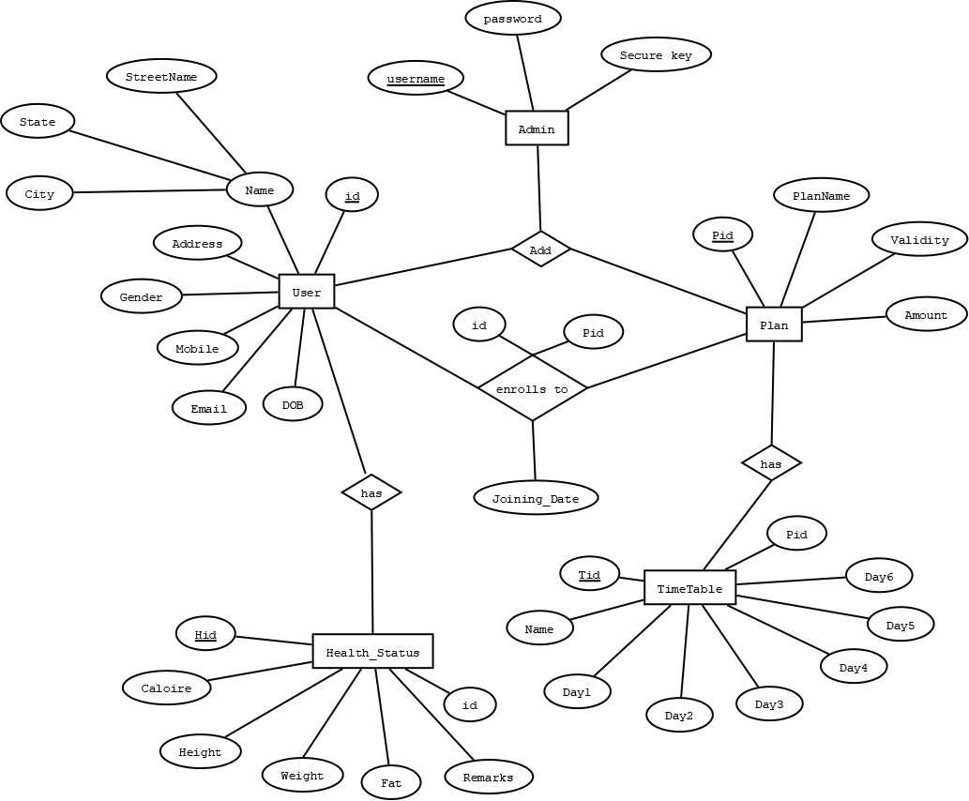
ER diagram

Slide 10
Relational
Diagram

Slide 11
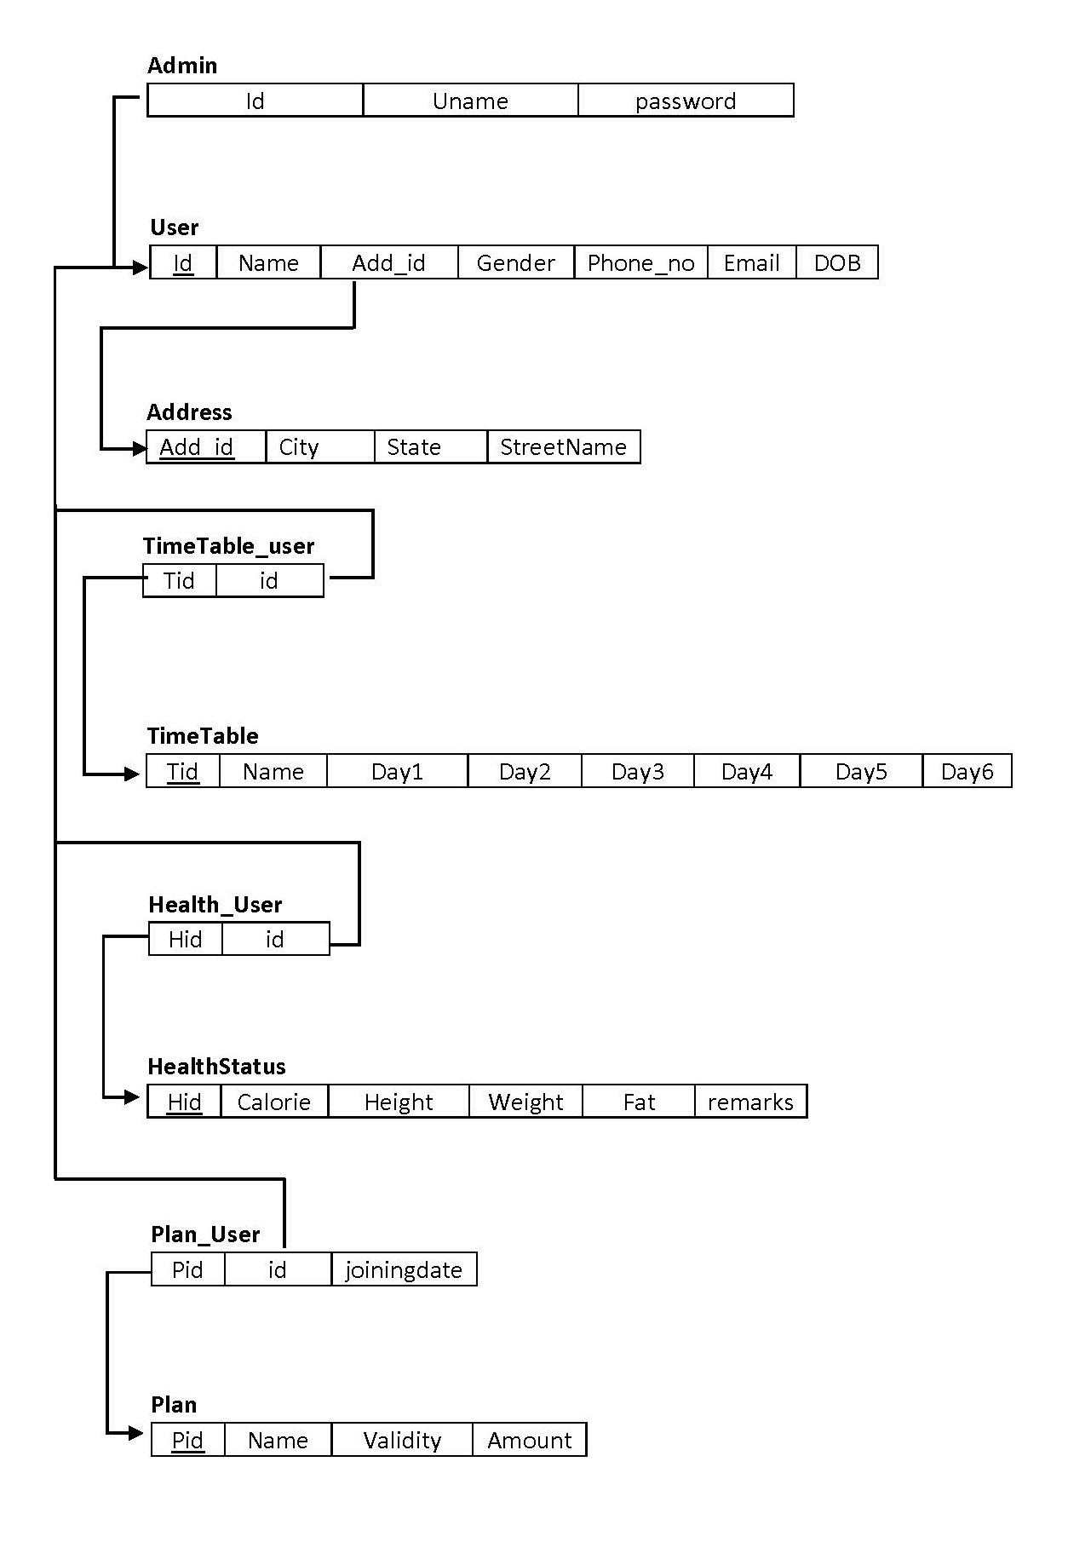

Slide 12
Thank You

